Slide 1
Software Development Life Cycle

Slide 2
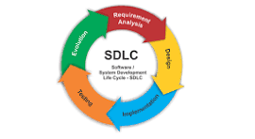
What is SDLC
SDLC is the project management frame work which describe the steps or stages of the development process.
There are 7 steps or phases in the SDLC
Planning :- Create the plan for project
Requirement Analysis :- Gather all required material
Design :- Design the model for software
Coding :- Start the coding
Testing :- Test the code work’s as per need
Deployment :- Deploy the project.
Maintenance :- keep the maintenance of the software as per feedback

Slide 3
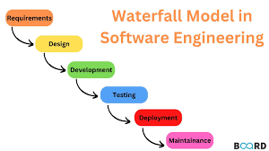
Types of SDLC Model
Water fall model :- It is linear approach of creating the software.
Drawbacks:
It is time consuming
Lot of documentation
No imp for feedback
Changes can’t be made once the process started
Create difficulty for large projects

Slide 4
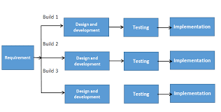
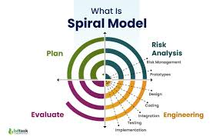
Iterative model :- These model breaks down the large project into small parts than solve each part of the project.
Drawbacks:-
Takes lot of time
Require high skill resource
Require lot more resources
Huge complexity for large project
Spiral model :- address the limitations of other SDLC models, such as the Waterfall model basically combines elements of both design and prototyping-in-stages
Drawbacks :-
Highly complex.
Resource management.
Time consuming
Lack of resource can lead to customer dis-satisfaction.

Slide 5
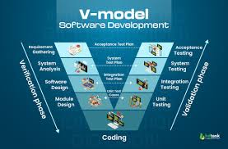
V model :- Verification and Validation model. a software development methodology that's used to represent the relationship between the phases of development and testing in the Software
Drawback :-
Inflexibility
Time consuming
Risk of overlapping phases
AS per all these model V-model is best.
AS V-model works on feedback and customer satisfaction.
Improved quality
Increased efficiency
Reduced costs

